Slide 1
Animal Adaptations
By: Mrs Kessel’s Class

Slide 2
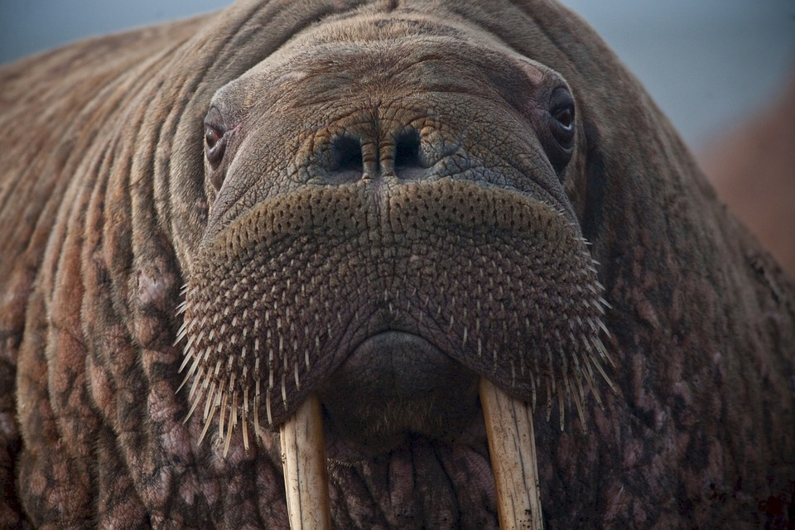
WALURUS
By Rainey Keith
Structural Adaptations- Very big teeth,blubbery body,bristly whiskers,high -suction lips.
Behavioral adaptations-A Walrus can stay under water for 30 minutes.
Diet-
They eat clams.
Home Base-
Northern Icy Waters.
Other Facts-
Did you know a Walrus can eat up to 6000 clams in one meal!!!

Slide 3
Cheetahs life style
By Rigo Fogg
Cheetahs eat gazelles, springbok, impala, and hares. A Thompson's gazelle, the cheetah
Cheetahs live mostly in open area of African and parts of Asia.
Lions and wild dogs and leopards and other animal will kill adult and baby cheetahs
Cool fact cheetahs can run up to speeds of over 70 miles

Slide 4
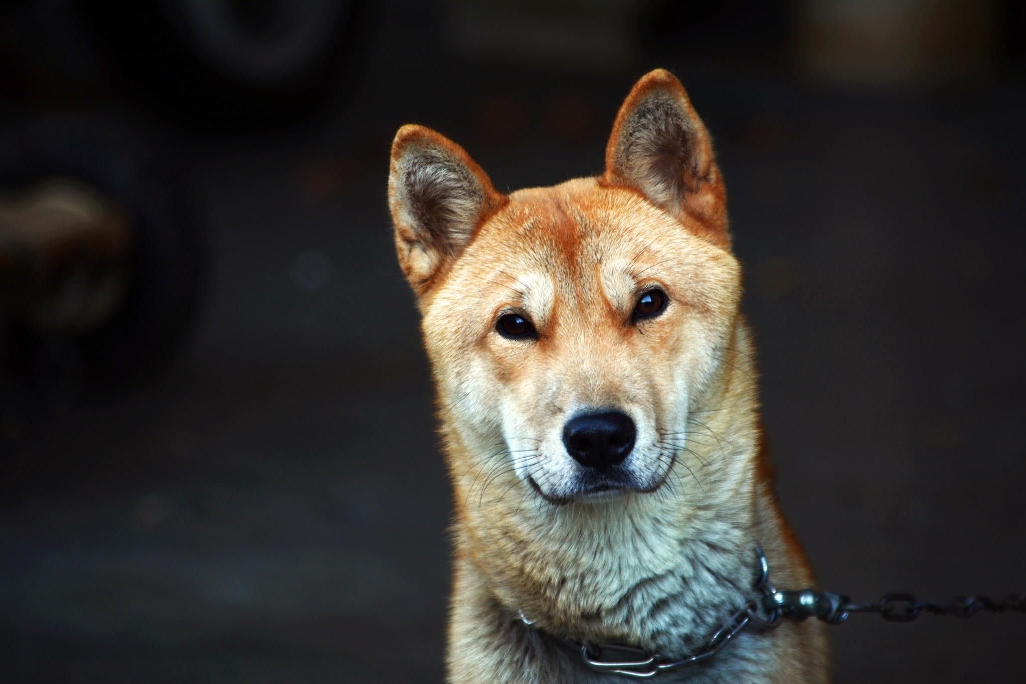
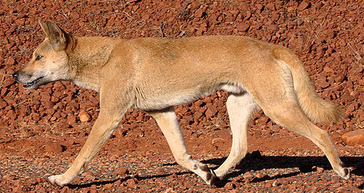
Dingo!
By:Jorge

Slide 5
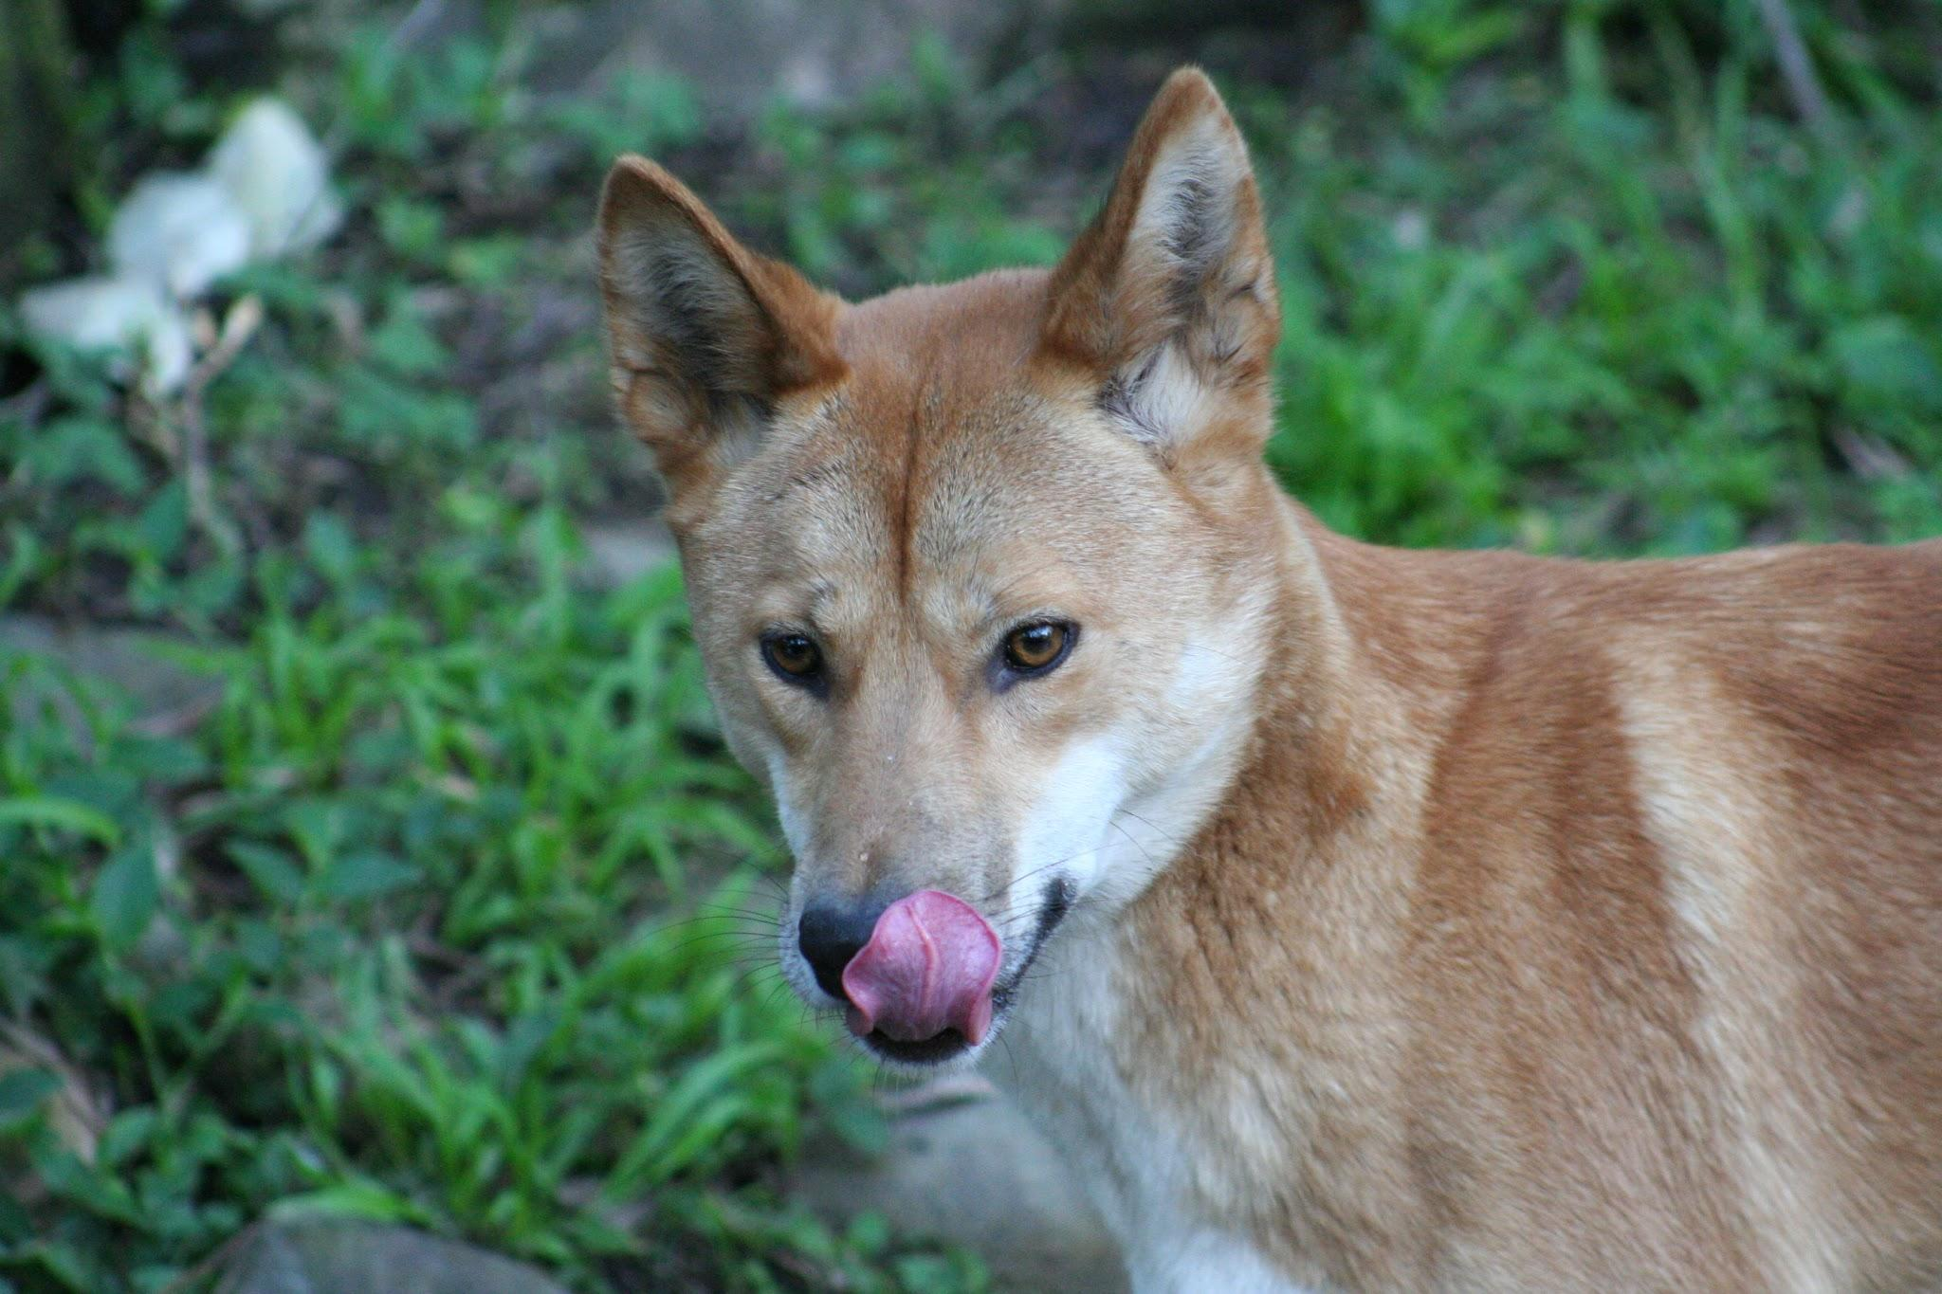
Dingo by Jorge Medina Triminio
Dingo habitat is australia
Dingo structural adaptation is that they have sharp eyesight to see their prey
Dingo eat rabbits,kangaroo,
And wombats
Dingo behavioral adaptation is that they use there color skin to camouflage
An interesting fact about the dingo is they attack people
Notes:
R color skin

Slide 6
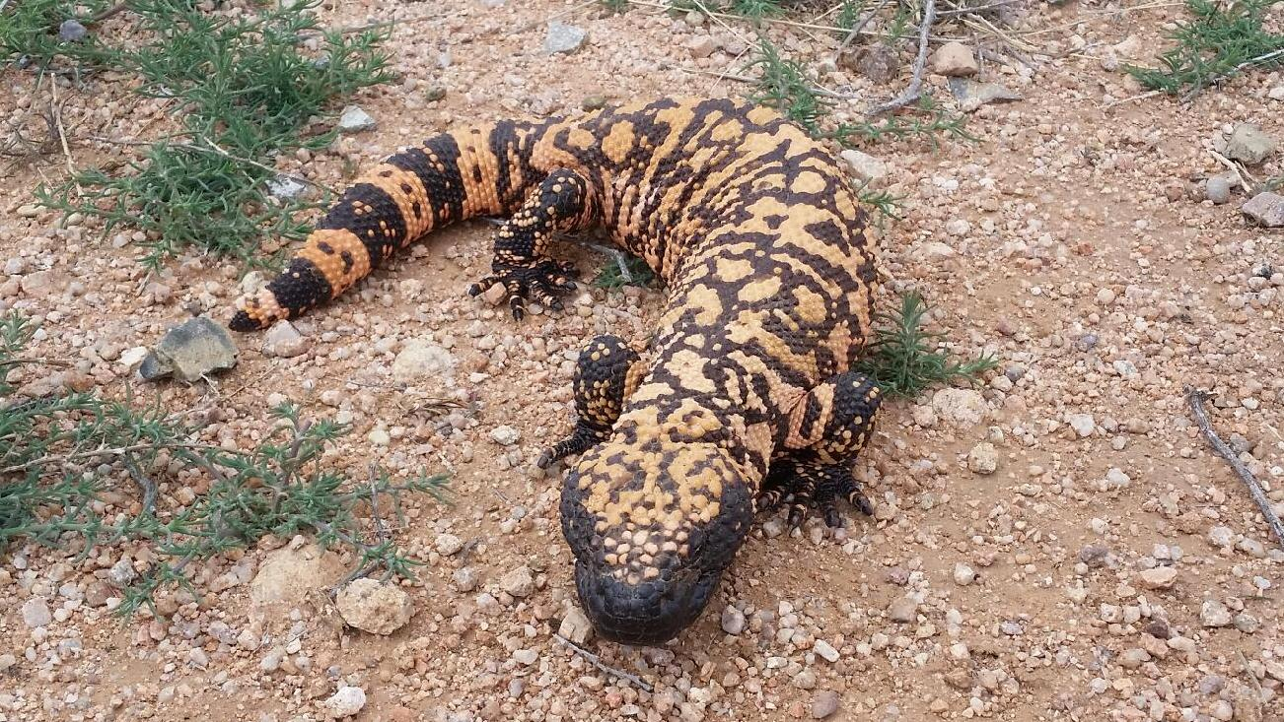
GILA MONSTER
By Riley Tittle
Behavioral
Adaptations
Gila monsters have an excellent sense of smell to dig up nests buried underground!
Structural
Adaptations
They can store fat in their oversized tails and go months between meals!
Food And Health
Gila monsters feed mainly on bird and reptile eggs, but will also eat small birds, small mammals, frogs, lizards, insects and carrion
FUN FACTS
Although the Gila's bite is extremely painful, no human death has been reported.
HOME BACE
They live in the dry, arid regions such as the Mojave, Sonoran, and Chihuahuan Deserts of the southwestern U.S. and northwestern Mexico. They are named after the Arizona Gila River Basin, where they were first discovered. Gila monsters are more likely to use their venom on a predator than on prey.

Slide 7
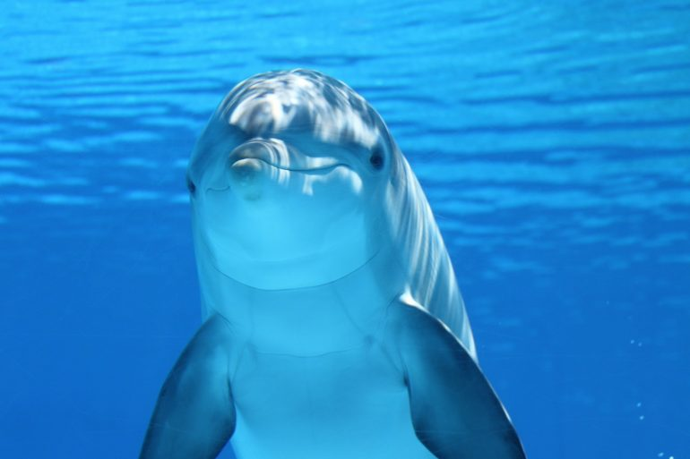
Dolphin
By Rylee Harrison
Structural adaptation
Is their fins because without HABITAT They are found in warm oceans.
Them they wouldn’t be able to swim. Diet They eat fish.
Behavior adaptation An interesting fact is they love to play there whole life.
Is that they are fast swimmer and can reach speeds up to 18 mph.

Slide 8
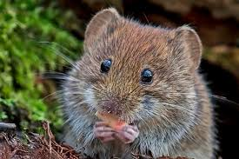
Vole
By Montia Tyson
predator
Snakes,all owls,foxes,hawks
prey
Smalll plants,grass,sedgh,flowers,fruit
Home base
They live in the grass

Slide 9
Cheetahs by Hunter Hudson
Cheetahs use their fur to blaned with the glass a cheetahs use their speed to runaway the cheetahs live in africa and they eat gazelles they are the fast animals in the word

Slide 10
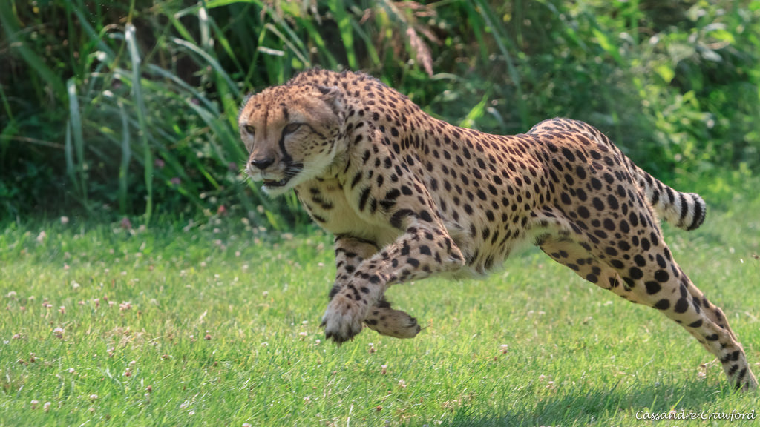
Cheetahs by Daniel Mills
Cheetahs are mostly found in sub-Saharan Africa and in eastern and southern African parks.
The cheetah is the world's fastest land animal. They can run 70 mph (or 110 kph), which is as fast as cars drive on the highway.
Their very long tail helps with balance when they run and leap.They are also the only cat without retractable claws, so perhaps digging in with their claws is another factor in their in their running abilities.
A behavioral adaptation of the cheetah is that it moves quietly in the tall grass up on their prey.
In general, the diet of the cheetah consists of gazelles, wildebeest calves, impalas, and smaller hoofed animals in its habitat.

Slide 11
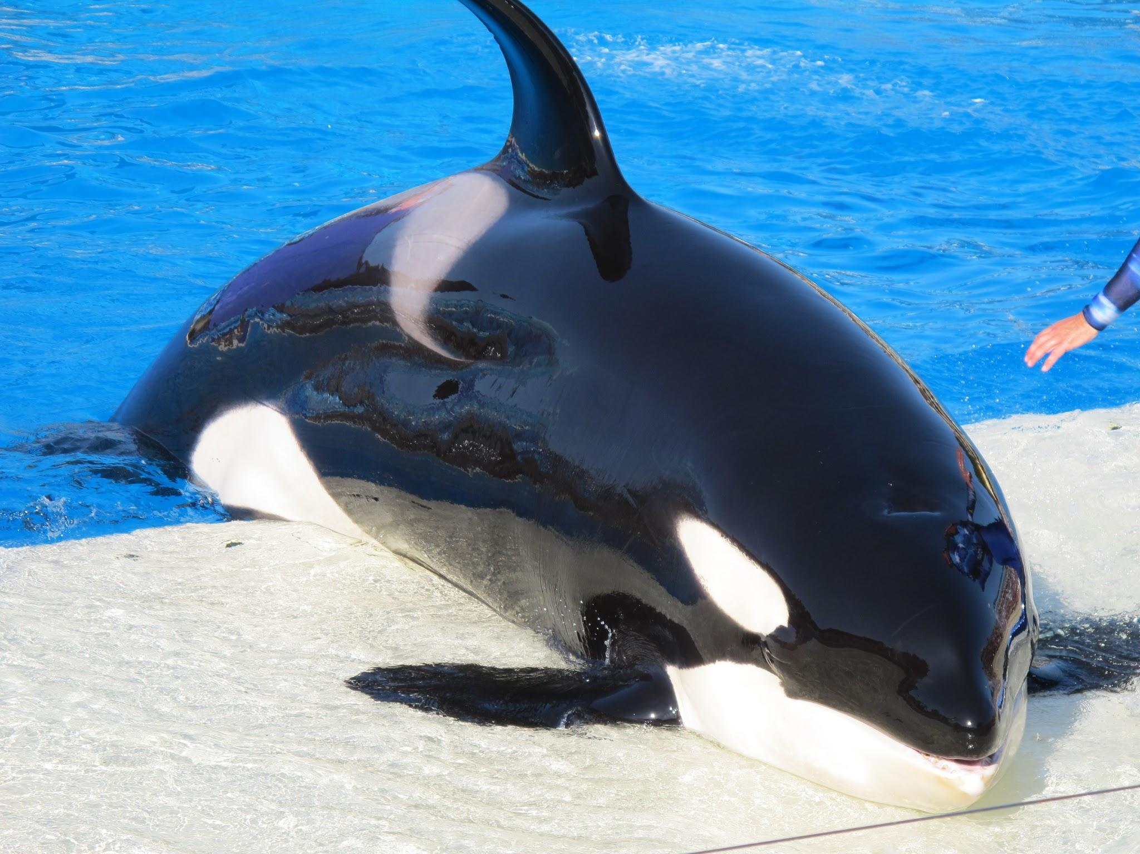
Orca by Sarah Suggs
Structural adaptations
They have a blowhole on the top of them to breathe.they also swim very fast.
Behavioral adaptations
They make calls to send messages
Habitat
On the coastal waters
Diet
Seals and sea lions
Cool facts
They live in groups called pods

Slide 12
Dingo
By Joshua Nobles
Unlike other dogs, dingo does not bark. It howls like a wolf.
Dingo can reach 3.5 to 4 feet in length and 22 to 33 pounds in weight. Dingo has bushy tail that is usually 12 to 13 inches long
Dingo can live a solitary life or be a part of a pack. One pack usually consists of 10 animals. Dingoes that are living in a group hunt their prey cooperatively.
Dingo has pointed muzzle, big canine teeth and very large, upright ears. Dingo is able to rotate its head for almost 180 degrees in both directions

Slide 13
Cheetah
By Devin McAldud

Slide 14
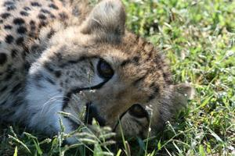
Cheetah by Celey Newcomb
Structural
-Her light body, long legs and super flexible backbone all help the cheetah cover lots of ground.
-Her claws and long tail help her keep her balance and traction when making high speed turns.
Behavioral
-Cheetahs are the fastest runner on the planet.
Interesting Fact
-Cheetah’s have amazing eyesight! Black Stripes under their eyes help them see up to a mile away!
Habitat
-Cheetah’s live mostly in open areas in Asia.
Prey
-Cheetahs eat gazelles, springbok, impala, and hares.

Slide 15
TASMANIAN DEVIL by Holden Forbes
STRUCTURAL: YOU think it looks cute but it looks really scary . BEHAVIORAL: IT looks really weak but it can crunch through bones like a pretzels. HABITAT: IT lives in tasmania. WHAT THEY EAT: tasmanian devils favorite food is rotten carcasses.A INTERESTING FACT: IS only small tasmanian devils can climb tree so they can get a better smell

Slide 16
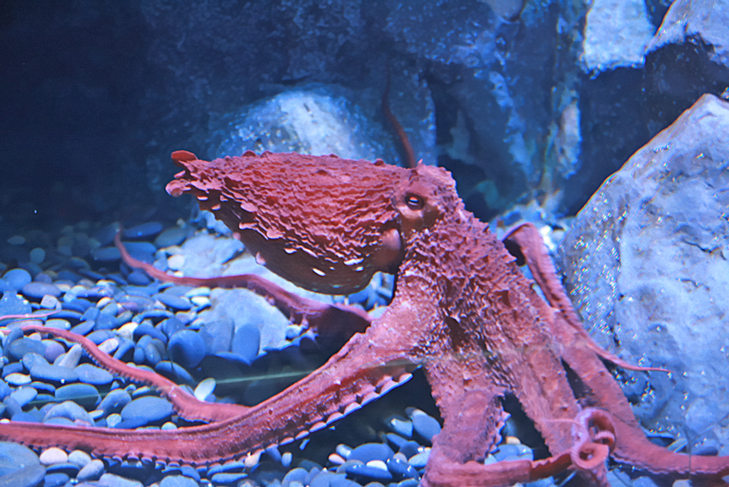
GIANT
PACIFIC
OCTOPUS
By Bailey McLawhorn
STRUCTURAL ADAPTATIONS
The structural adaptations of an octopus is that they can camouflage instantly!They can also regenerate arms.
HABITAT THEY LIVE IN
This octopus is found further north than other octopie.
BEHAVIORAL ADAPTATION
The octopus can let out an ink defense.They can jet away from predators too.
WHAT THEY EAT
The giant pacific octopus eats clams.
FUN FACTS
The giant pacific octopus can be up to 600 pounds!

Slide 17
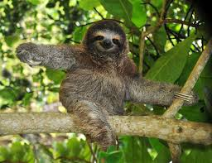
SLOTH
By Erin Baxter
Behavioral Adaptations
They may be slow but when they are in danger they are good swimmers so the can get away from predators.
Structural adaptations
The sloth spends most of its time in tree’s they can do this because of their long claws.
Diet
They eat leaves,plants and fruits.
Habitat
Some of the places they live are in Costa Rica,Panama and Eastern Puru
Fun Fact
The sloth is the slowest mammal in the world

Slide 18
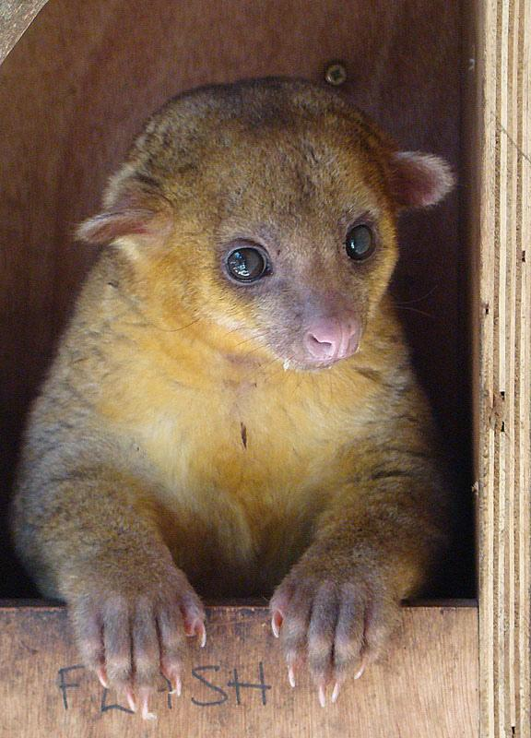
Kinkajou
Habitat
Kinkajous live in the tropical treetops. They range from southern Mexico,through Central and South America down to the Mato Grasso region of Brazil.
What It Eats
Kinkajous drink nectar from flowers,eat juicy fruits and use their long tongue to get honey from bee hives. They also eat insects and small mammals.
Predators
A kinkajous predators are jaguars and other big cats,falcons,hawks and other birds of prey all prey on the Kinkajou.
Structural Adaptations
A kinkajou can defend itself by running fast screaming or biting and clawing predators.
By Mya Lugo
Interesting Fact
Kinkajous are able to turn their feet in the opposite direction and run backward as fast as they can run forward.
Behavioral Adaptations
They have long prehensile tails, and clawed fingers made for living in trees.

Slide 19
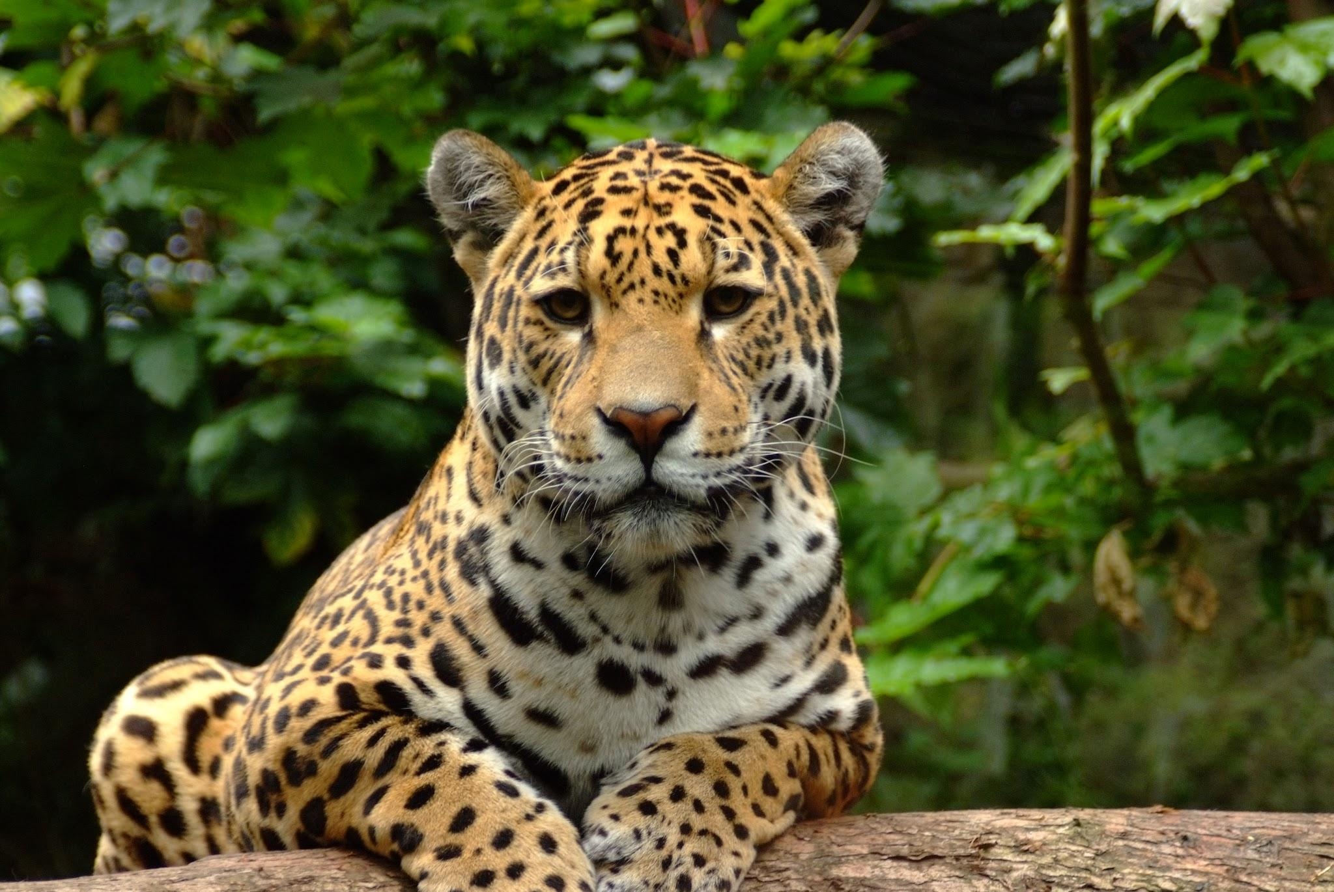
Cheetah by Olivia Baker
One behavioral adaptation is that the cheetah is very fast which helps it get away from its predator.
One structural adaptation is the cheetahs tail because it helps it balance on sharp turns.
The cheetah eats gazelles hares springbokand impala. The cheetah lives in the lightly wooded African and Asia.

